Slide 1

Amity School of Engineering Technology NTCC (Project – 5TH Semester)
Student Name: Atharv Gupta
Enrollment No: A2345921019
Programme Name: B.Tech CSE Evening

Slide 2

Song Recommendation System
Amity School of Engineering Technology
Topic:

Slide 3



Introduction
Amity School of Engineering Technology
AIM: To produce a great music taste recommendation.
The research investigates the efficacy of machine learning-based music recommendation systems, focusing on personalized selections through shared filtering, content-based filtering, and hybrid algorithms.

Slide 4

Amity School of Engineering Technology
Methods Used:
Content Based Filtering: Content-based filtering recommends songs based on their intrinsic features and characteristics, catering to user preferences.
Collaborative Filtering: Utilizing collaborative-based filtering to enhance song recommendation systems by leveraging user preferences and patterns.

Slide 5
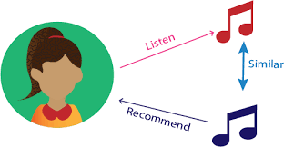
Purpose of the Study
Amity School of Engineering Technology
The system's goal is to offer consumers personalised music recommendations based on their listening habits and interests. The collaborative filtering and content-based filtering techniques are combined in the recommendation algorithm to increase the recommendations' relevance and accuracy.

Slide 6
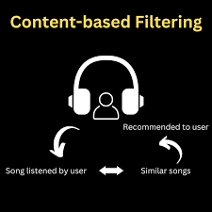
Content Based Filter
Amity School of Engineering Technology

Slide 7
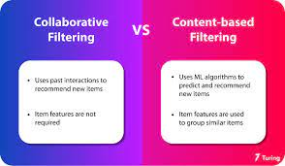
Amity School of Engineering Technology

Slide 8
Review of Literature [ Tabular] Form
Amity School of Engineering Technology
Topic | Site URL | Methodology
Liverpool John Moores University | https://www.liip.ch/en/blog/sentiment-detection-with-keras-word-embeddings-and-lstm-deep-learning-networks | APIs
Music Storage | https://sites.google.com/site/mbawithfun/home/mba-projects/mba-projects/arbitrage-trade-analysis-of-stock-trading-in-nse-and-bse | Music Dataset

Slide 9
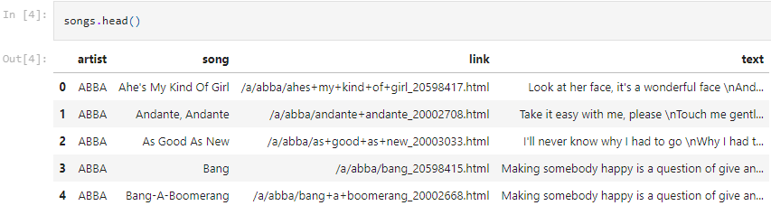
Research Methodology
Amity School of Engineering Technology
The following methods have been used for the research in analysis of the study:
Python APIs
Dataset (5000 Songs)
Training Model

Slide 10
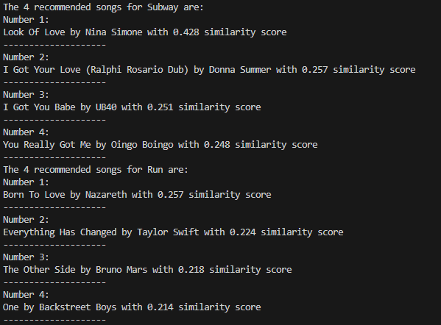
Analysis [Objective Wise]
Amity School of Engineering Technology
New Terms learnt:
Content Based Filter
Collaborative Filter
APIs

Slide 11
Findings of The Study
Amity School of Engineering Technology
A model with a dense layer was made.
To calculate the accurate Recommendation, the model needs to be trained extensively.
Training Set- The data used for training the neural network.
Test set- The data used for testing the performance of the neural network.

Slide 12
Conclusion
Amity School of Engineering Technology
For the purpose of recommending songs. The Song dataset (5000 songs) dataset, was utilised to do this.
1000 of them were utilised to test the network's performance after we had used 4000 of them to train it.
For each class, 5 outputs show the probability.
The probability distribution was generated using the softmax activation function.

